Slide 1
CIS 612 Analysis of Twitter Data Through MongoDB and Hive
Submitted By
Himanshu Sharma : 2659211
Kalpesh Sharma : 2660576

Slide 2
Python Code to get Twitter Data
#!/usr/bin/env python
from tweepy.streaming import StreamListener
from tweepy import OAuthHandler
from tweepy import Stream
#Variables that contains the user credentials to access Twitter API
access_token = "4228035318-DbQPCpfOsbb4uFRztbR8QVamuQL7fJnYnWhsN7i"
access_token_secret = "9N2wmHp8OVBfYgHqnV3wASEy6JtGIgFnMfSD5CXbJBI20"
consumer_key = "E98J8oZPMdTwN3r2KyflNf71A"
consumer_secret = "eI9ulGU10skpH4gmhby2AamfGsK5r5C81IIP4vE8PBpqbrEwog"

Slide 3
Conti..
#This is a basic listener that just prints received tweets to stdout.
class StdOutListener(StreamListener):
def on_data(self, data):
print data
return True
def on_error(self, status):
print status
if __name__ == '__main__':
#This handles Twitter authetification and the connection to Twitter Streaming API
l = StdOutListener()
auth = OAuthHandler(consumer_key, consumer_secret)
auth.set_access_token(access_token, access_token_secret)
stream = Stream(auth, l)
#This line filter Twitter Streams to capture data by the keywords
stream.filter(track=['globalwarming', 'global warming', 'ParisClimateConference', 'cybermonday','LHHHReunion','wine','beer','whisky','rum','vodka'])

Slide 4
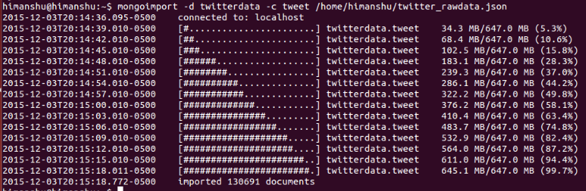
Inserting Data into MongoDB
> mongoimport -d twitterdata -c tweet twitter_rawdata.json

Slide 5
Creating Map Reduce Function for Top 10 Retweets
m = function () {
emit({user:this.in_reply_to_screen_name}, {count:1});
}
r = function (k, v) {
var count = 0;
v.forEach(function (value) {count += value.count;});
return {count:count};
}
q = { "in_reply_to_screen_name" : { "$ne" : null } }
db.tweet.mapReduce(m, r, {out: "top_retweets", query: q});
> db.top_retweets.find({}).sort({"value.count":-1}).limit(10);

Slide 6
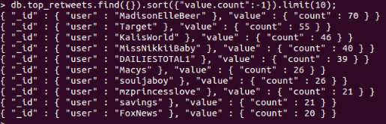
Map Reduce Output for Top 10 Retweets
{ "_id" : { "user" : "MadisonElleBeer" }, "value" : { "count" :70 } }
{ "_id" : { "user" : "Target" }, "value" : { "count" : 55 } }
{ "_id" : { "user" : "KalisWorld" }, "value" : { "count" : 46 } }
{ "_id" : { "user" : "MissNikkiiBaby" }, "value" : { "count" : 40 } }
{ "_id" : { "user" : "DAILIESTOTAL1" }, "value" : { "count" : 39 } }
{ "_id" : { "user" : "Macys" }, "value" : { "count" : 26 } }
{ "_id" : { "user" : "souljaboy" }, "value" : { "count" : 26 } }
{ "_id" : { "user" : "mzprincesslove" }, "value" : { "count" : 21 } }
{ "_id" : { "user" : "savings" }, "value" : { "count" : 21 } }
{ "_id" : { "user" : "FoxNews" }, "value" : { "count" : 20 } }

Slide 7
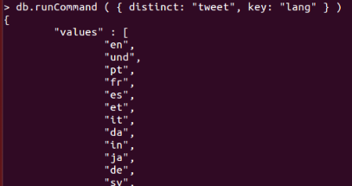
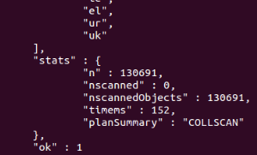
Number of languages
db.runCommand( { distinct: “tweet”,key: “lang” } )
The output of this query displayed list of all languages.
There were 43 languages

Slide 8
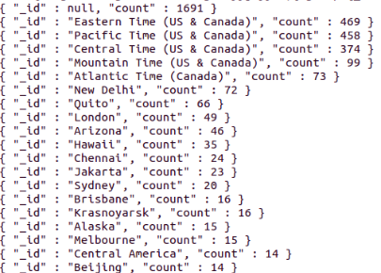
Number of tweets about Global warming from various time zones
db.tweet.aggregate( [ { $match: {$or: [{'text': {$regex:".*globalwarming.*"}},{'text': {$regex:".*GlobalWarming.*"}},{'text': {$regex: ".*global warming.*"}},{'text': {$regex: ".*Globalwarming.*"}},{'text': {$regex: ".*Global Warming.*"}},{'text': {$regex: ".*Global warming.*"}},{'text': {$regex: ".*global Warming.*"}}] }} ,{$group:{_id:"$user.time_zone", count:{$sum:1}} },{$sort: {count:-1}}])

Slide 9
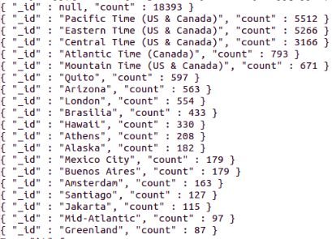
Number of tweets about Cyber Monday from various time zones
db.tweet.aggregate( [ { $match: {$or: [{'text': {$regex:".*cybermonday.*"}},{'text': {$regex: ".*CyberMonday.*"}},{'text': {$regex: ".*Cybermonday.*"}},{'text': {$regex: ".*cyberMonday.*"}}] }} ,{$group:{_id:"$user.time_zone", count:{$sum:1}} },{$sort: {count:-1}}])

Slide 10
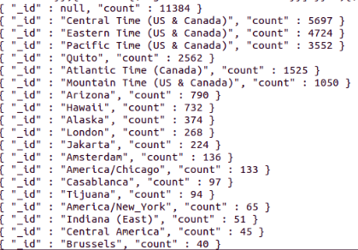
Number of tweets about LHHHReunion from various time zones
db.tweet.aggregate( [ { $match: {$or: [{'text': {$regex:".*LHHHReunion.*"}},{'text': {$regex: ".*LhhhReunion.*"}},{'text': {$regex: ".*lhhhreunion.*"}},{'text': {$regex: ".*Lhhhreunion.*"}}] }} ,{$group:{_id:"$user.time_zone", count:{$sum:1}} },{$sort: {count:-1}}])

Slide 11
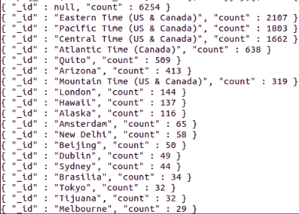
Number of tweets about Wine from various time zones
db.tweet.aggregate( [ { $match: {$or: [{'text': {$regex:".*Wine.*"}},{'text': {$regex: ".*wine.*"}},{'text': {$regex: ".*WINE.*"}}] }} ,{$group:{_id:"$user.time_zone", count:{$sum:1}} },{$sort: {count:-1}}])

Slide 12
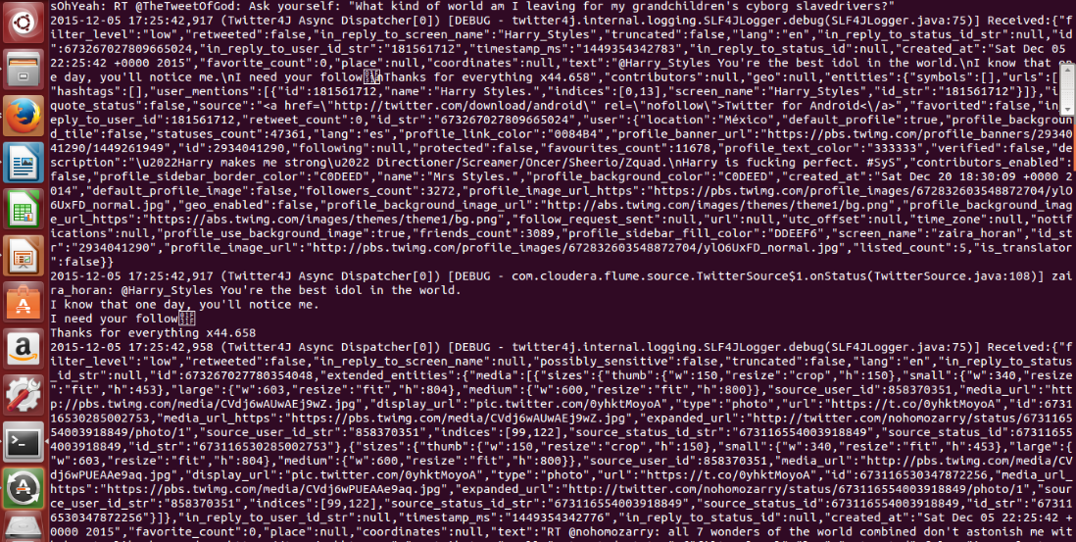
Starting Flume to Stream Tweets
/usr/local/flume/bin/flume-ng agent --conf ./conf/ -f /usr/local/flume/conf/flume.conf -Dflume.root.logger=DEBUG,console -n TwitterAgent

Slide 13
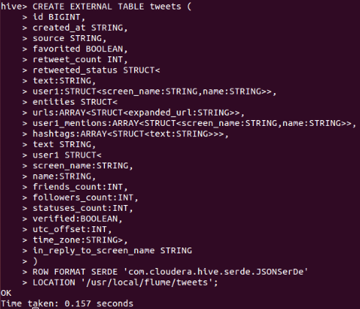
Creating Hive table to hold Twitter data

Slide 14
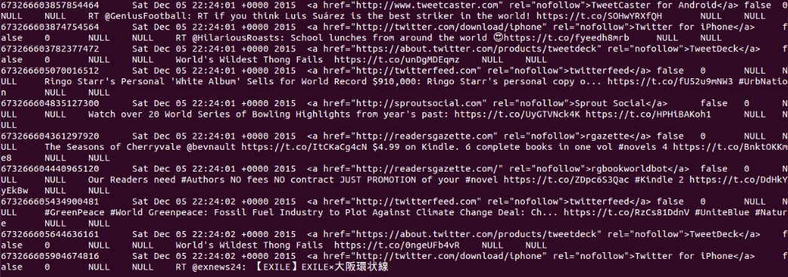
Selecting from Hive Table
SELECT t.retweeted_screen_name, sum(retweets) AS total_retweets, count(*) AS tweet_count FROM (SELECT retweeted_status.user1.screen_name as retweeted_screen_name, retweeted_status.text, max(retweet_count) as retweets FROM tweets GROUP BY retweeted_status.user1.screen_name, retweeted_status.text) t GROUP BY t.retweeted_screen_name ORDER BY total_retweets DESC LIMIT 10;

Slide 15
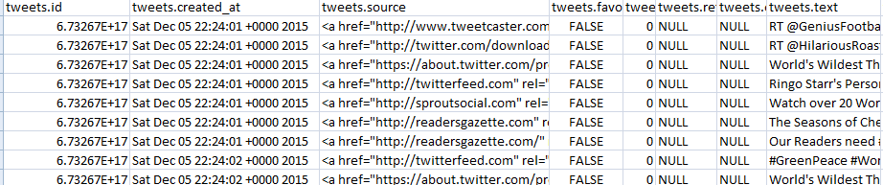
Sending Hive table to CSV file
hive -e 'set hive.cli.print.header=true; select * from tweets' | sed 's/[\t]/,/g' > tweets_table.csv

Slide 16
Python Code to Analyze Data
import json
import pandas as pd
import re
tweets_data_path = 'twitter_rawdata.json'
tweets_data = []
tweets_file = open(tweets_data_path, "r")
for line in tweets_file:
try:
tweet = json.loads(line)
tweets_data.append(tweet)
except:
continue;
print 'Total Tweets', len(tweets_data)

Slide 17
Conti..
tweets = pd.DataFrame()
tweets['text'] = [tweet.get('text','') for tweet in tweets_data]
tweets['lang'] = [tweet.get('lang','') for tweet in tweets_data]
tweets_by_lang = tweets['lang'].value_counts()
print 'Number of Languages ', len(tweets_by_lang)
tweets['place'] = [tweet.get('place','') for tweet in tweets_data]
tweets_by_cont = tweets['place'].value_counts()
print 'Number of Places ', len(tweets_by_cont)

Slide 18
Conti..
def word_in_text(word, text):
word = word.lower()
text = text.lower()
match = re.search(word, text)
if match:
return True
return False
tweets['globalwarming'] = tweets['text'].apply(lambda tweet: word_in_text('globalwarming', tweet))
tweets['global warming'] = tweets['text'].apply(lambda tweet: word_in_text('global warming', tweet))
tweets['ParisClimateConference'] = tweets['text'].apply(lambda tweet: word_in_text('ParisClimateConference', tweet))

Slide 19
Conti..
tweets['cybermonday'] = tweets['text'].apply(lambda tweet: word_in_text('cybermonday', tweet))
tweets['LHHHReunion'] = tweets['text'].apply(lambda tweet: word_in_text('LHHHReunion', tweet))
tweets['wine'] = tweets['text'].apply(lambda tweet: word_in_text('wine', tweet))
tweets['beer'] = tweets['text'].apply(lambda tweet: word_in_text('beer', tweet))
tweets['whisky'] = tweets['text'].apply(lambda tweet: word_in_text('whisky', tweet))
tweets['rum'] = tweets['text'].apply(lambda tweet: word_in_text('rum', tweet))
tweets['vodka'] = tweets['text'].apply(lambda tweet: word_in_text('vodka', tweet))

Slide 20
Conti..
print 'GlobalWarming ', tweets['globalwarming'].value_counts()[True]
print 'Global Warming ', tweets['global warming'].value_counts()[True]
print 'Paris Climate Conference ', tweets['ParisClimateConference'].value_counts()[True]
print 'Cyber Monday ', tweets['cybermonday'].value_counts()[True]
print 'LHHHReunion ', tweets['LHHHReunion'].value_counts()[True]
print 'Wine ', tweets['wine'].value_counts()[True]
print 'Beer ', tweets['beer'].value_counts()[True]
print 'Whisky ', tweets['whisky'].value_counts()[True]
print 'Rum ', tweets['rum'].value_counts()[True]
print 'Vodka ', tweets['vodka'].value_counts()[True]

Slide 21
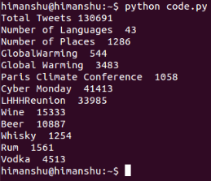
Output

Slide 22
Tweets Graphical Representation

Slide 23
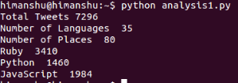
Python vs Ruby vs JavaScript

Slide 24
Python vs Ruby vs JavaScript

